Slide 1
Analysis of Ames Housing

Slide 2
Background
I am a working for an Auction House. I have a list of houses that I intend to put up for auction in Ames. I collected the past housing dataset in Ames to research and eventually set a minimum Sale Price of the houses for the auction.

Slide 3
objective
To seek approval to set the baseline price based on the predicted price for the list of houses

Slide 4
Data importing
There are 2 datasets namely test.csv and train.csv
The price column is the target variable
The rest of the variables are the features
There are missing data in both train and test dataset on the numeric fields
I replaced the null values with 0 in both train and test dataset

Slide 5
Data importing
Cleaning of data in raw dataset
Fields | Final Field | Remarks
Bsmt Full Bath, Bsmt Half Bath, Full Bath, Half Bath, | Total Baths | Consolidate all the baths data into one field
Total Bsmt SF, Gr Liv Area, Wood Deck SF, Open Porch SF, Enclosed Porch, 3Ssn Porch, Screen Porch | totalsqft | Sum up all the area in a house
Garage Finish, Garage Yr Blt, Garage Type | has_finished_garage, Detached Garage | transformed the categorical ‘Garage Finish’ column into ‘Has Finished Garage’ and ‘Has Detached Garage’ using one-hot encoding to indicate finished vs unfinished garages. All remaining garage columns were dropped
Year Remod/Add, Year Built | is_remodelled | I introduced a new field to indicate that the house has been remodelled

Slide 6
Data importing
Cleaning of data in raw dataset
Fields | Final Field | Remarks
BsmtFin Type 2, BsmtFin Type 1 | Has Finished Basement | There were multiple categorical columns describing type of basement finish, so I converted these into a one-hot encoded ‘Has Finished Basement’ column
Pool QC | has_pool | ‘Pool QC’ changed to ‘Has Pool’
Fence | has_fence | ‘Fence’ changed to ‘Has Fence’
Paved Drive | has_paved_drive | ‘Paved Drive’ changed to ‘Has Paved Drive’
Central Air | has_central_air | ‘Central Air’ changed to ‘Has Central Air’

Slide 7
Data importing
Cleaning of data in raw dataset
Fields | Final Field | Remarks
Lot Config, MS Zoning, Misc Feature, Neighbourhood, House Style, Bldg Type |  | A number of categorical variables were transformed into dummy column
Bsmt Qual, Bsmt Cond, Fireplace Qu, Heating QC, Garage Qual, Garage Cond, Exter Qual, Exter Cond, Kitchen Qual, Exter Qual, Exter Cond |  | Quality rankings - transforming categorical vairables to ordinal ones
'Year Built’ | age | Turning the 'Year Built' column into 'Age'
Drop all the non numerical fields

Slide 8
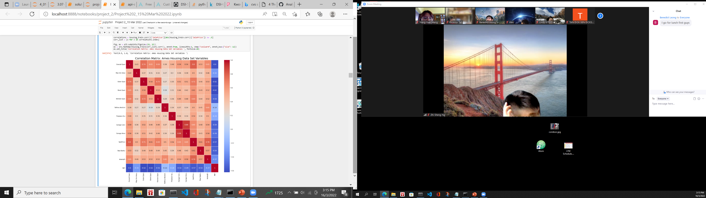
Correlation of predictors
These are the set of predictors with absolute correlation> 0.5 with respect to SalePrice

Slide 9
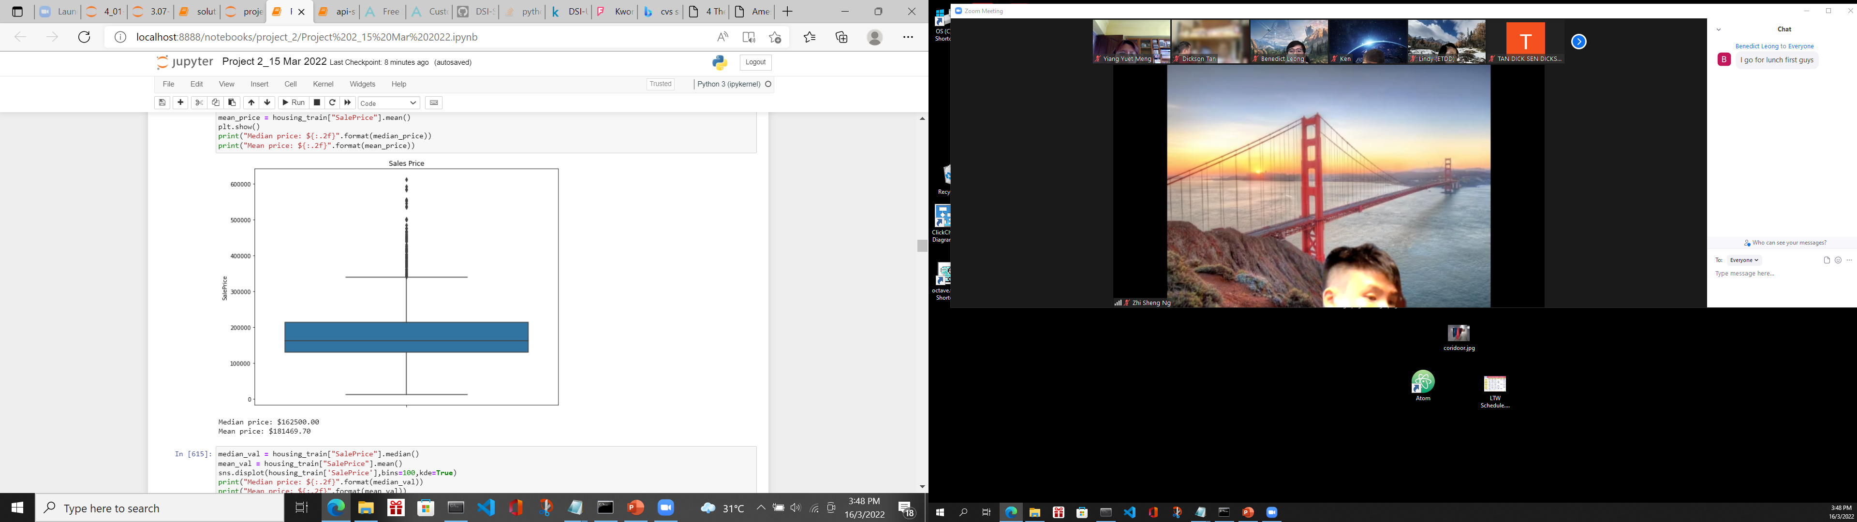
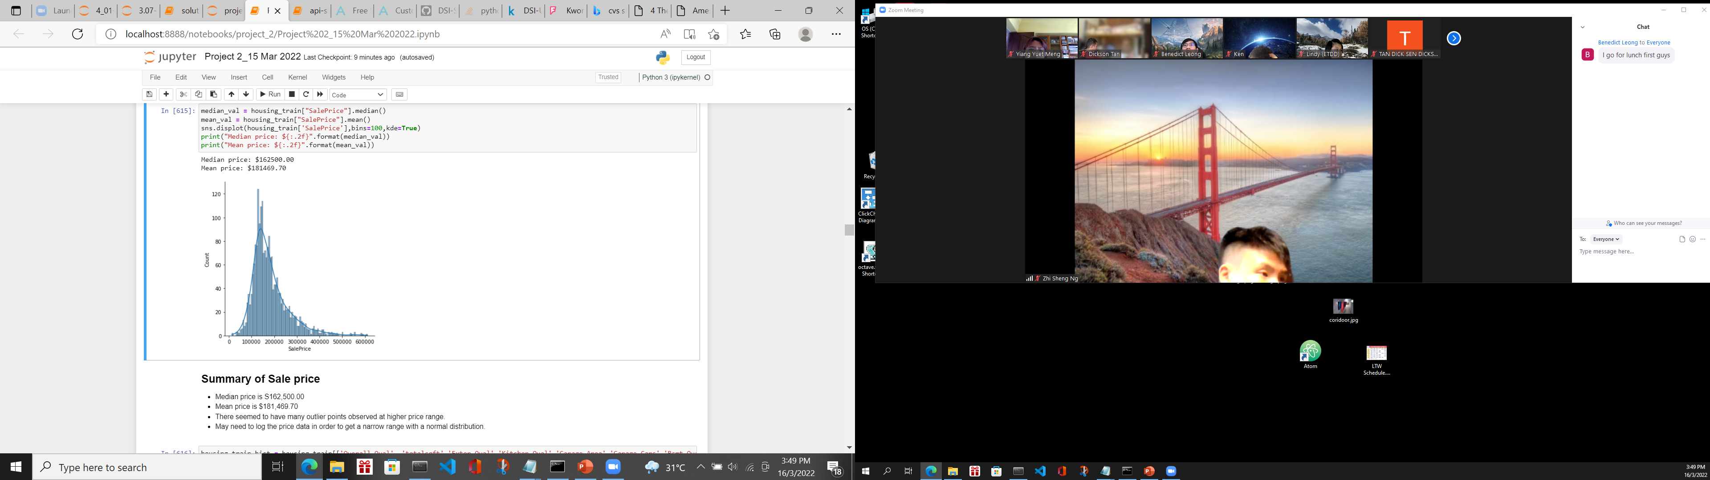
EDA – sale price
Everything looks good here, with no missing values. A tail extends to high prices. There seemed to have many outlier points observed at higher price range. I will log the price data in order to get a narrow range with a normal distribution

Slide 10
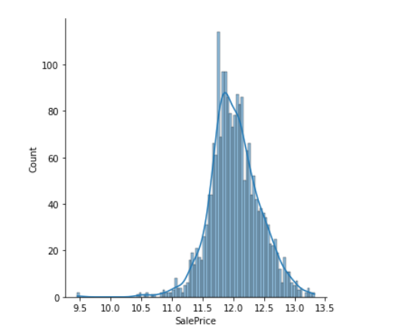
EDA – sale price
After I perform a logarithmic transformation of the Sale Price, it made highly skewed distributions less skewed

Slide 11
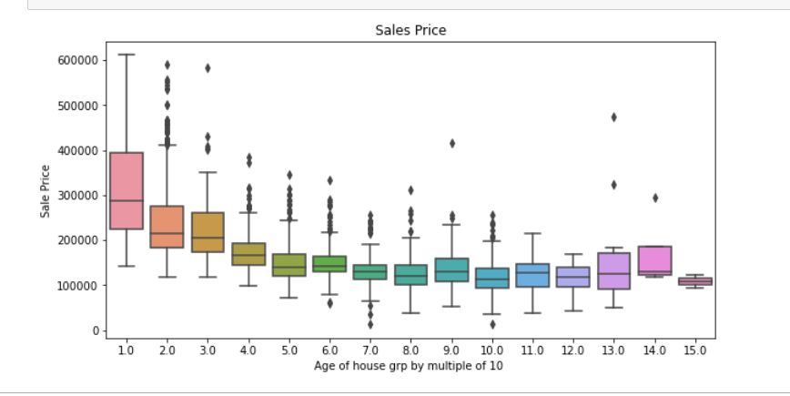
EDA – sale price wrt to age of house
I defined the age of the building as the year of sale minus the year of construction. New houses have a price premium that declines as they age even by 10 to 20 years. After a while the effect of age plateaus off, only to come back for very old houses.

Slide 12

EDA – sale price wrt overall quality
Overall Quality of the houses from one to ten. It turns out they are great predictors of sale price, with higher quality and commanding higher prices

Slide 13
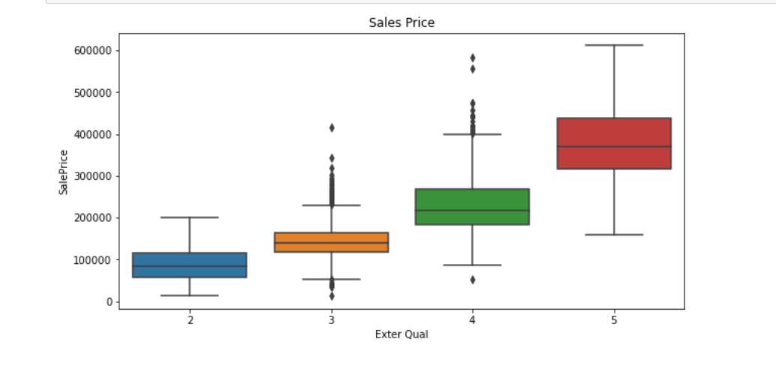
EDA – sale price wrt external quality
External Quality of the houses from one to ten. It turns out they are great predictors of sale price, with higher quality and commanding higher prices

Slide 14
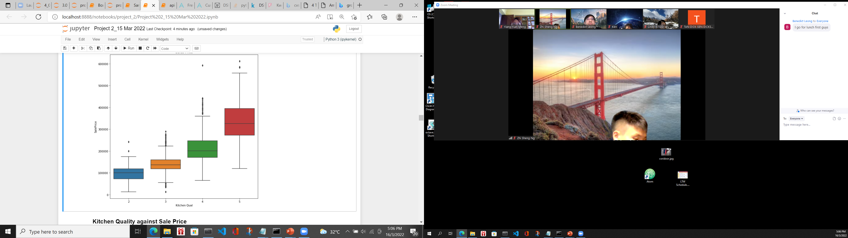
EDA – sale price wrt Kitchen Quality
Kitchen Quality of the houses from one to ten. It turns out they are great predictors of sale price, with higher quality and commanding higher prices

Slide 15
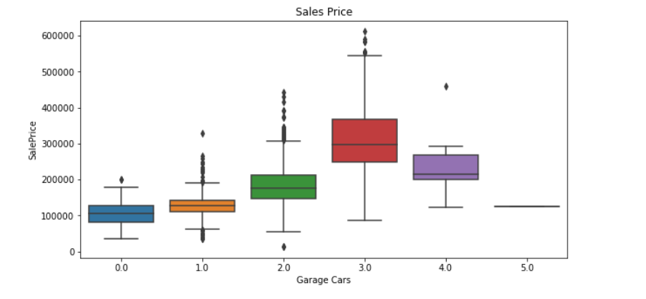
EDA – sale price wrt garage cars
Sale Price increases with the increase in garage cars. Once it reaches 4 Garage cars, the price decreases

Slide 16

EDA – sale price wrt Basement quality
Sale Price increases with the increase in basement quality.

Slide 17
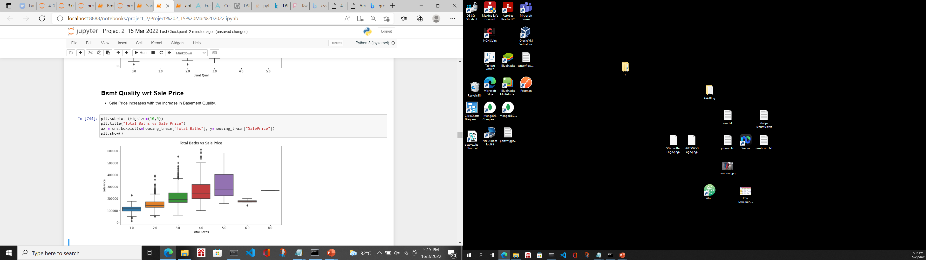
EDA – sale price wrt no of baths
Sale Price increases with the increase in no of baths. When it is beyond 5, it will not have effect on the price

Slide 18
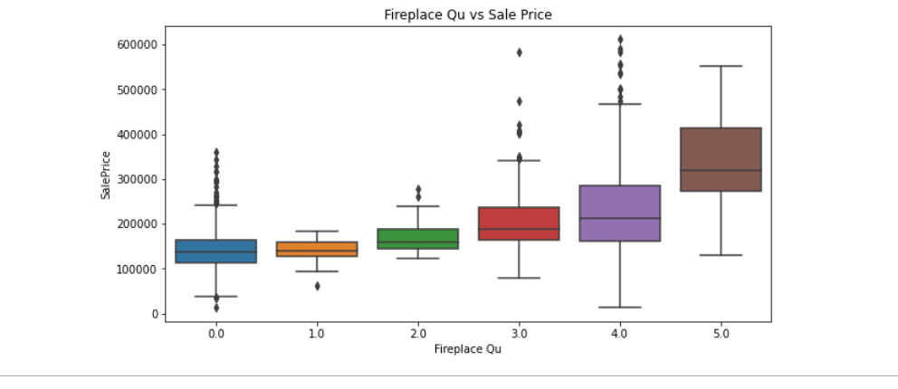
EDA – sale price wrt fireplace quality
Sale Price increases with the increase in Fireplace Quality.

Slide 19
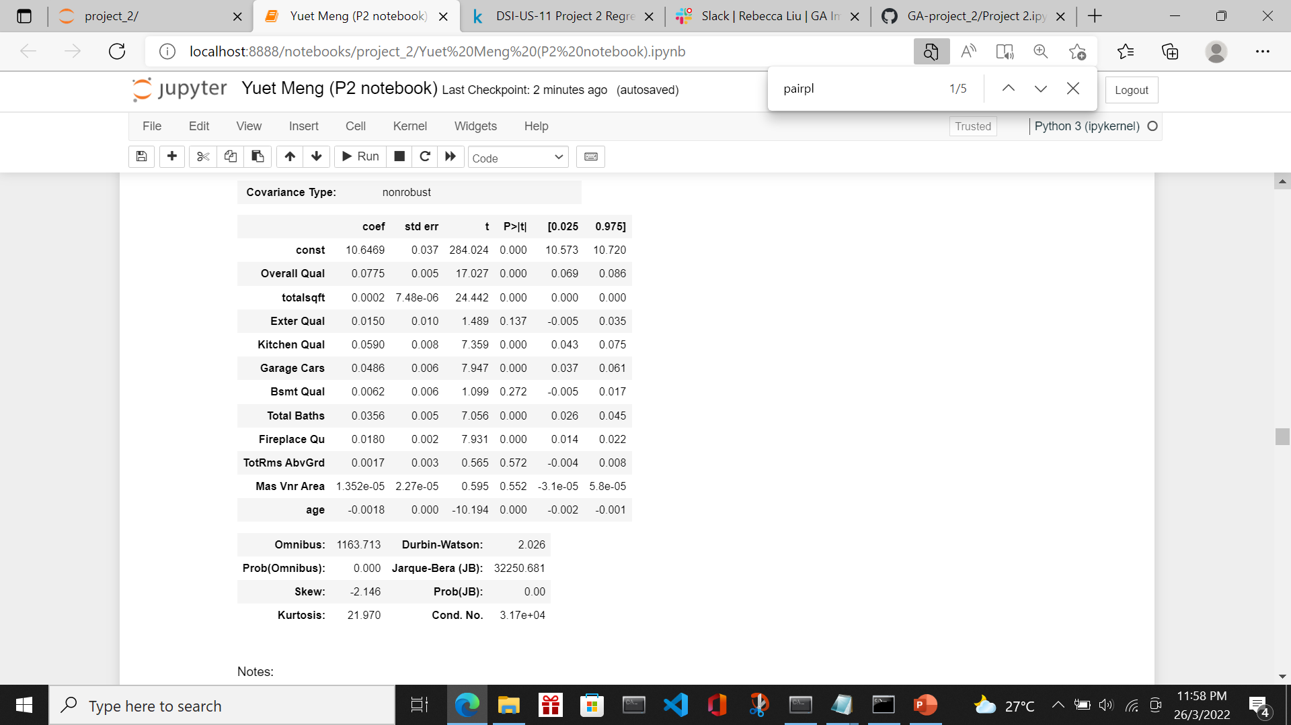
Feature engineering
P Value of 'Exter Qual', 'Mas Vnr Area' are more than 0.05 which is not significant. I decide to remove these features from the mode

Slide 20
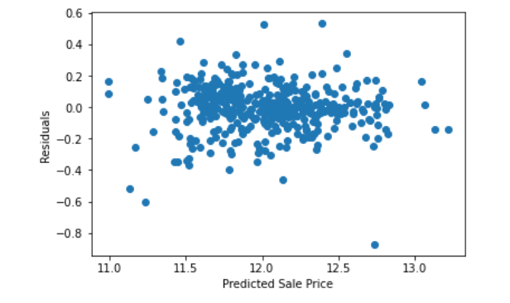
Train/score/evaluate of models
I set a baseline model
Baseline model used variables: Overall Qual, totalsqft, Exter Qual, Kitchen Qual, Garage Cars,
Bsmt Qual, Total Baths, Fireplace Qu, TotRms AbvGrd, Mas Vnr Area, age
Model | Degree | MSE (train) | MSE (test) | CVS
Linear Regression | 1 | 0.023862165669055902 | 0.02267001237644348 | 0.02442597939937667
Model | Degree | Residue vs Predicted Plot | Remark
Linear Regression | 1 |  | The points in the plot are pretty symmetrically distributed tending to cluster towards the middle of the plot

Slide 21
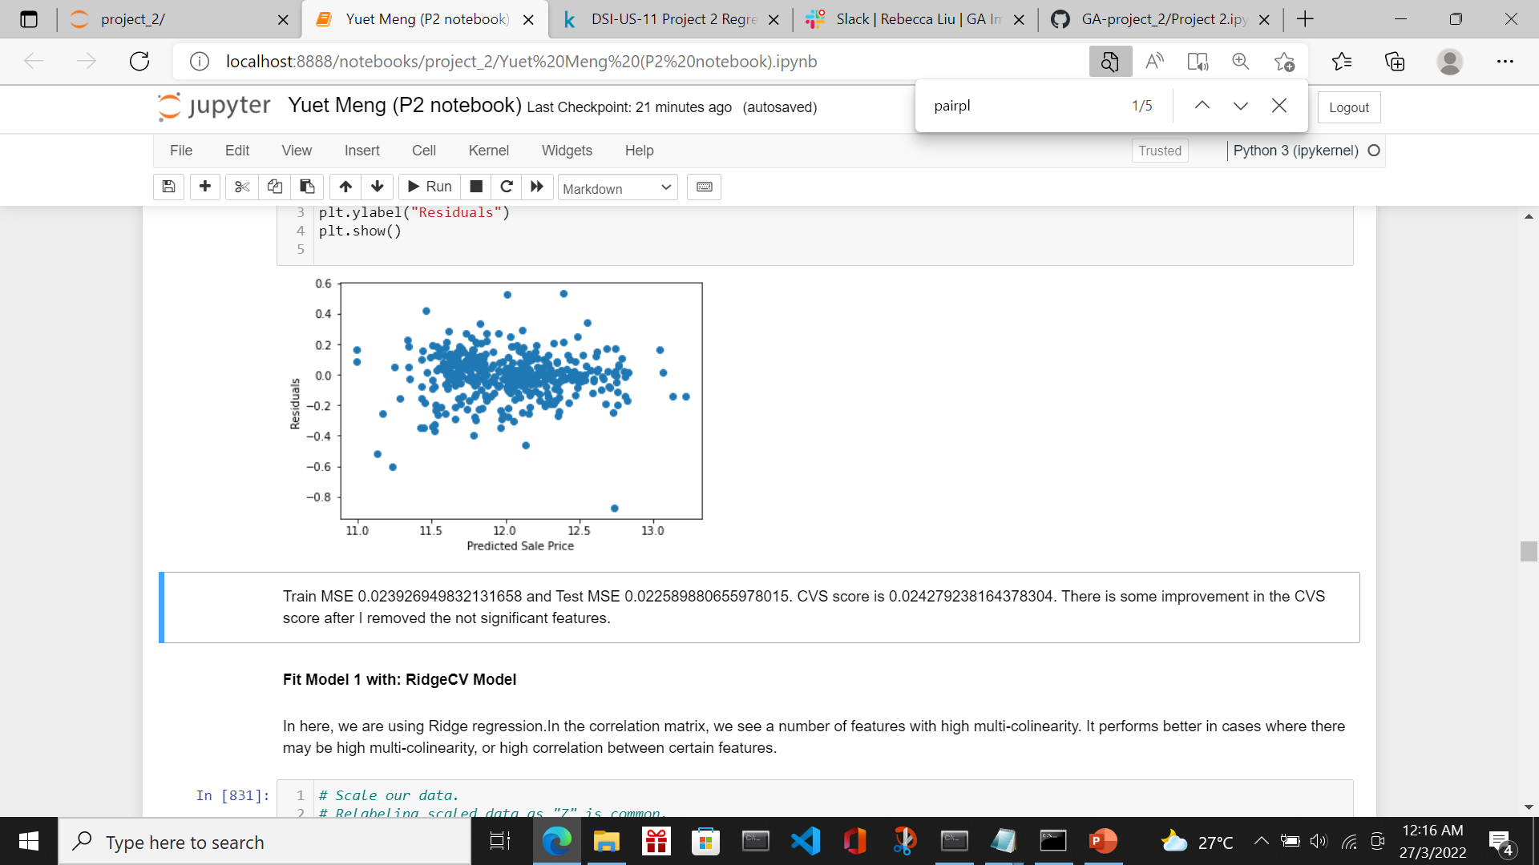
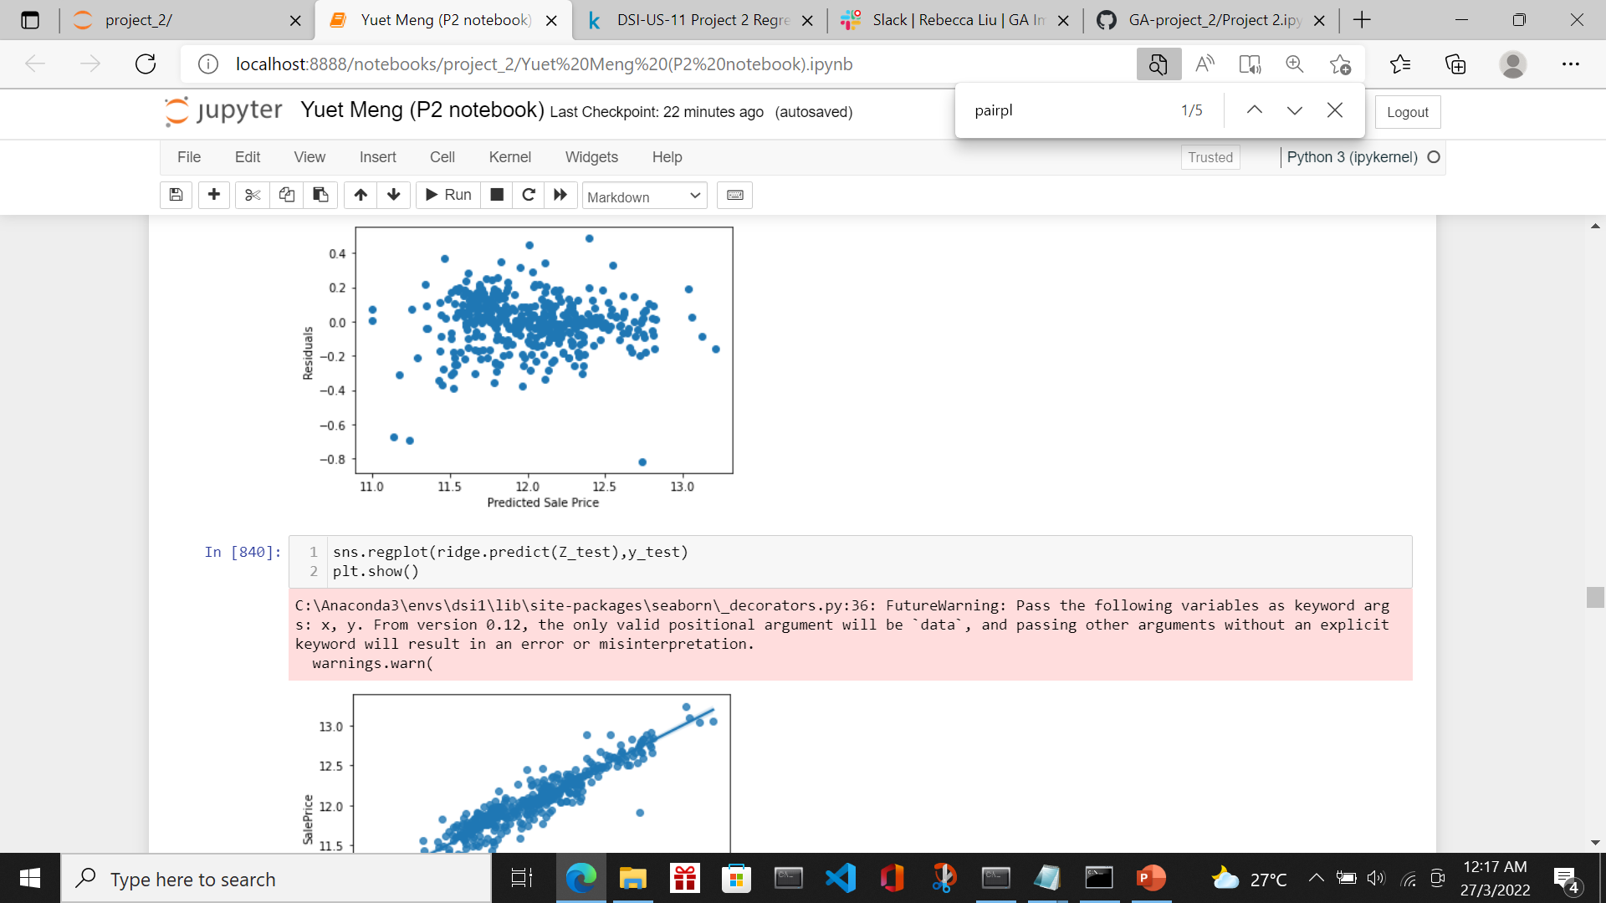
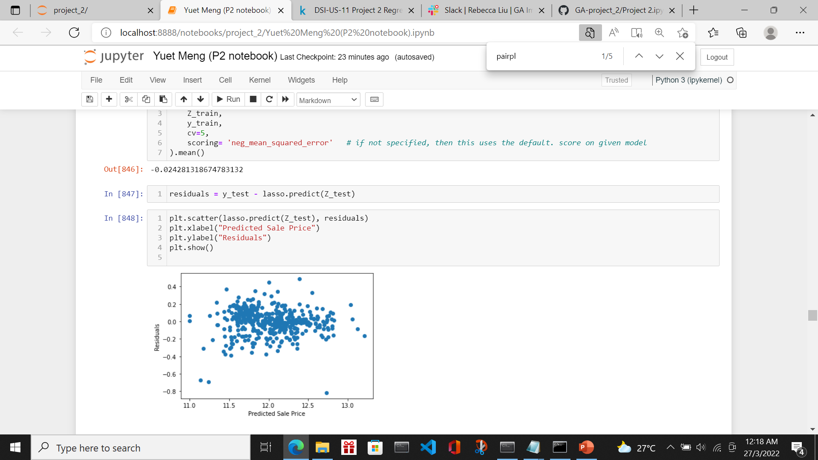
Train/score/evaluate of models
I trained and tested 4 models
Model 1 used variables: Overall Qual, totalsqft, Kitchen Qual, Garage Cars,Total Baths,
Fireplace Qu, age
I tested using Linear Regression, Ridge Regression and Lasso Regression
Model | Degree | Residue vs Predicted Plot | Remark
Linear Regression | 1 |  | The points in the plot are pretty symmetrically distributed tending to cluster towards the middle of the plot
Ridge Regression | 1 |  | The points in the plot are pretty symmetrically distributed tending to cluster towards the middle of the plot
Lasso Regression | 1 |  | The points in the plot are pretty symmetrically distributed tending to cluster towards the middle of the plot

Slide 22
Train/score/evaluate of models
Model 1 Scores
Model | Degree | MSE (train) | MSE (test) | CVS | Remark
Linear Regression | 1 | 0.023926949832131658 | 0.022589880655978015 | 0.024279238164378304
Ridge Regression | 1 | 0.02392817964988823 | 0.02258433059028586 | 0.02427708430597085 | Best among Model 1
Lasso Regression | 1 | 0.02392882548841778 | 0.02258909916851307 | 0.024281318674783132

Slide 23
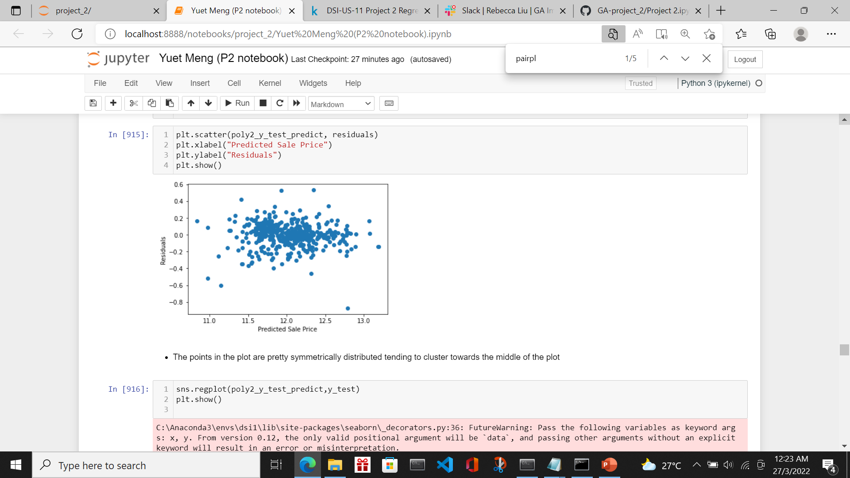
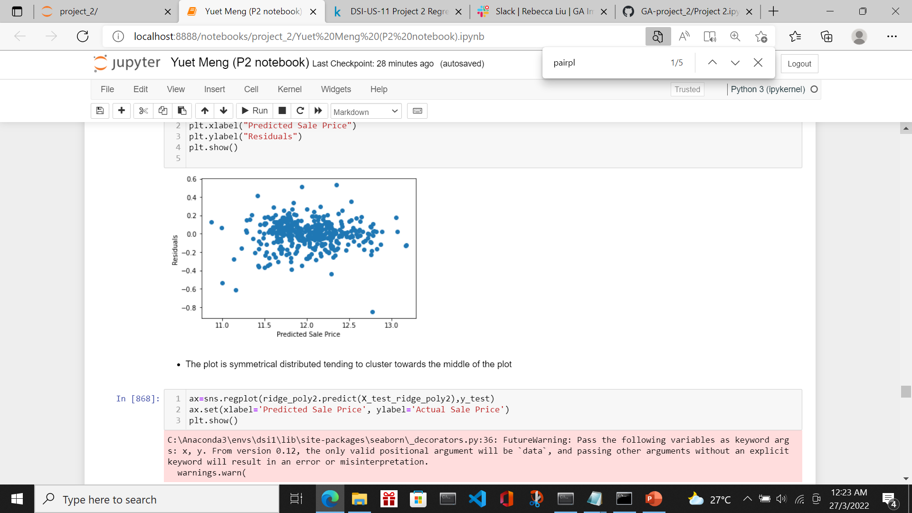
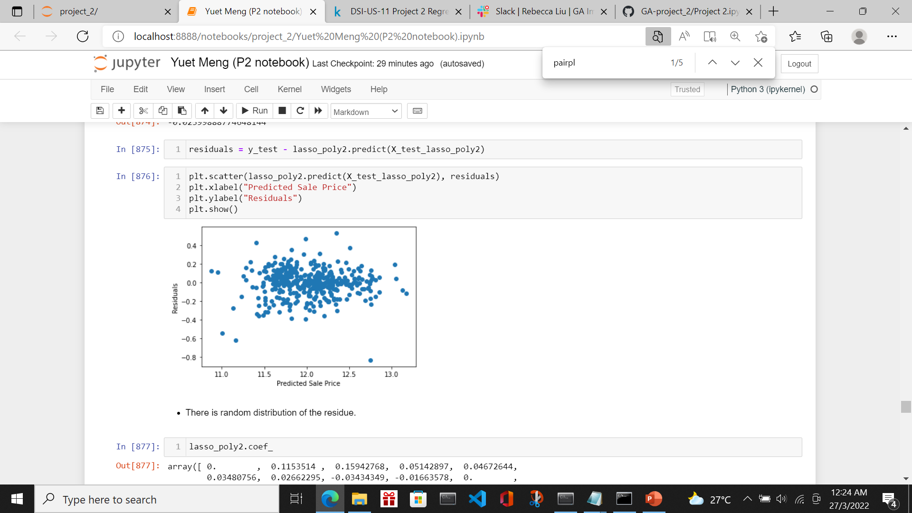
Train/score/evaluate of models
Model 2 used variables: Overall Qual, totalsqft, Kitchen Qual, Garage Cars,Total Baths,
Fireplace Qu, age but with polynomial Degree 2
I tested using Linear Regression, Ridge Regression and Lasso Regression
Model | Degree | Residue vs Predicted Plot | Remark
Linear Regression | 2 |  | The points in the plot are pretty symmetrically distributed tending to cluster towards the middle of the plot
Ridge Regression | 2 |  | The points in the plot are pretty symmetrically distributed tending to cluster towards the middle of the plot
Lasso Regression | 2 |  | The points in the plot are pretty symmetrically distributed tending to cluster towards the middle of the plot

Slide 24
Train/score/evaluate of models
Model 2 Scores
Model | Degree | MSE (train) | MSE (test) | CVS | Remark
Linear Regression | 2 | 0.02192103 | 0.02200216 | 0.024460194133659883
Ridge Regression | 2 | 0.022023794923807127 | 0.021761534481688397 | 0.024241644882198758
Lasso Regression | 2 | 0.022539032281693936 | 0.02185415307219567 | 0.02399888774648144 | Best among model 2

Slide 25
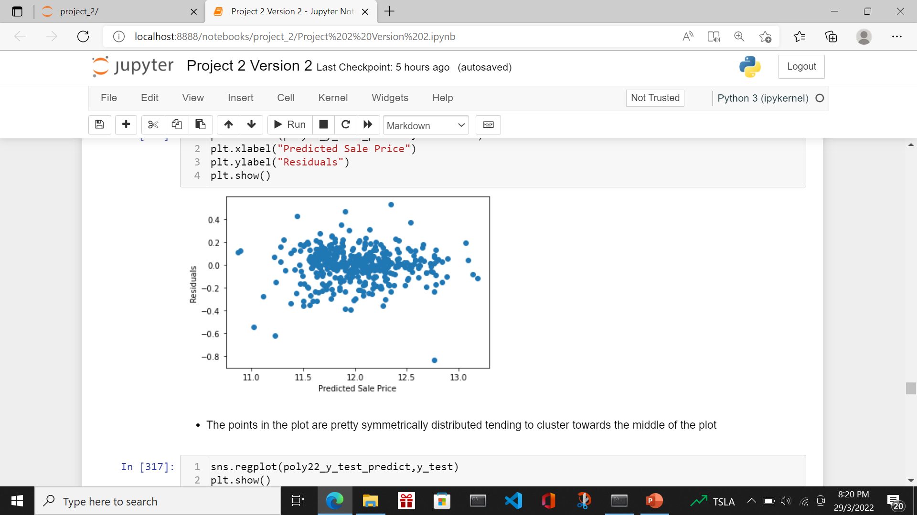
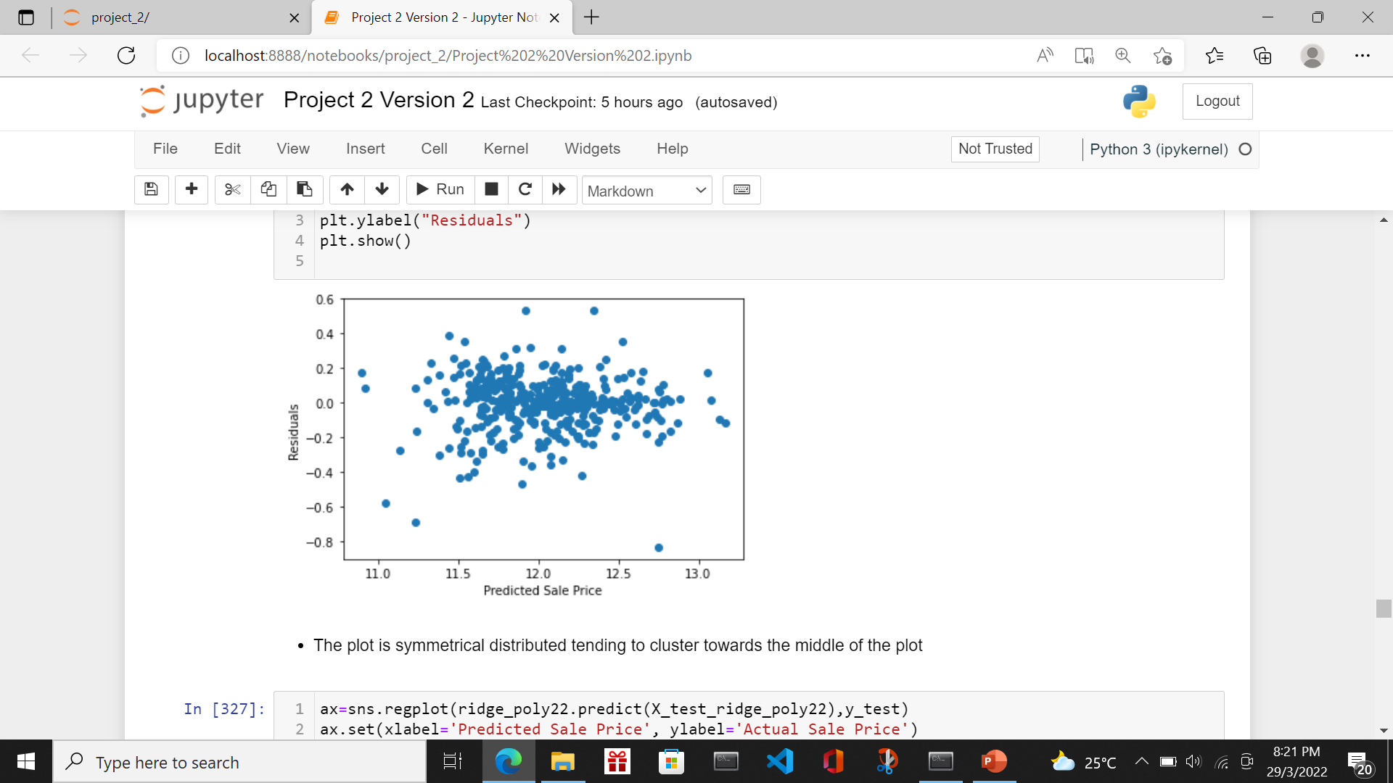
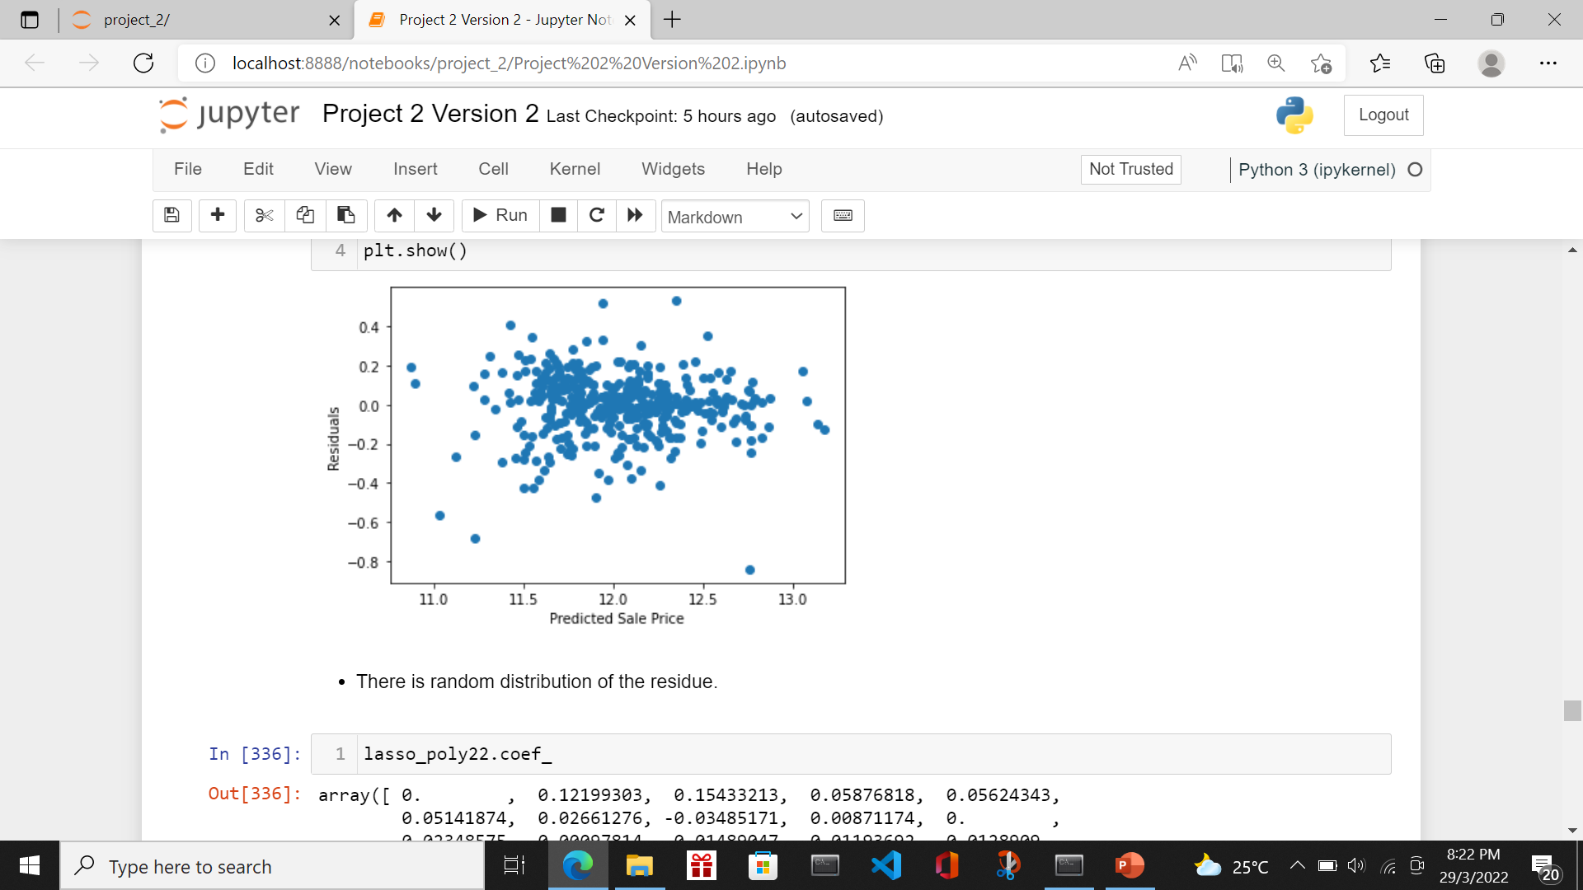
Train/score/evaluate of models
Model 3 used variables: Overall Qual, totalsqft, Kitchen Qual, Garage Cars,Total Baths,
Fireplace Qu but with polynomial Degree 2
I tested using Linear Regression, Ridge Regression and Lasso Regression
Model | Degree | Residue vs Predicted Plot | Remark
Linear Regression | 2 |  | The points in the plot are pretty symmetrically distributed tending to cluster towards the middle of the plot
Ridge Regression | 2 |  | The points in the plot are pretty symmetrically distributed tending to cluster towards the middle of the plot
Lasso Regression | 2 |  | The points in the plot are pretty symmetrically distributed tending to cluster towards the middle of the plot

Slide 26
Train/score/evaluate of models
Model 3 Scores
Model | Degree | MSE (train) | MSE (test) | CVS | Remark
Linear Regression | 2 | 0.02319557 | 0.02419273 | 0.025086988660436578
Ridge Regression | 2 | 00.023268444541707595 | 0.024117539956324784 | 0.024938207000677818
Lasso Regression | 2 | 0.023330669785984002 | 0.024226242692108962 | 0.024909124969940515 | Best among model 3

Slide 27
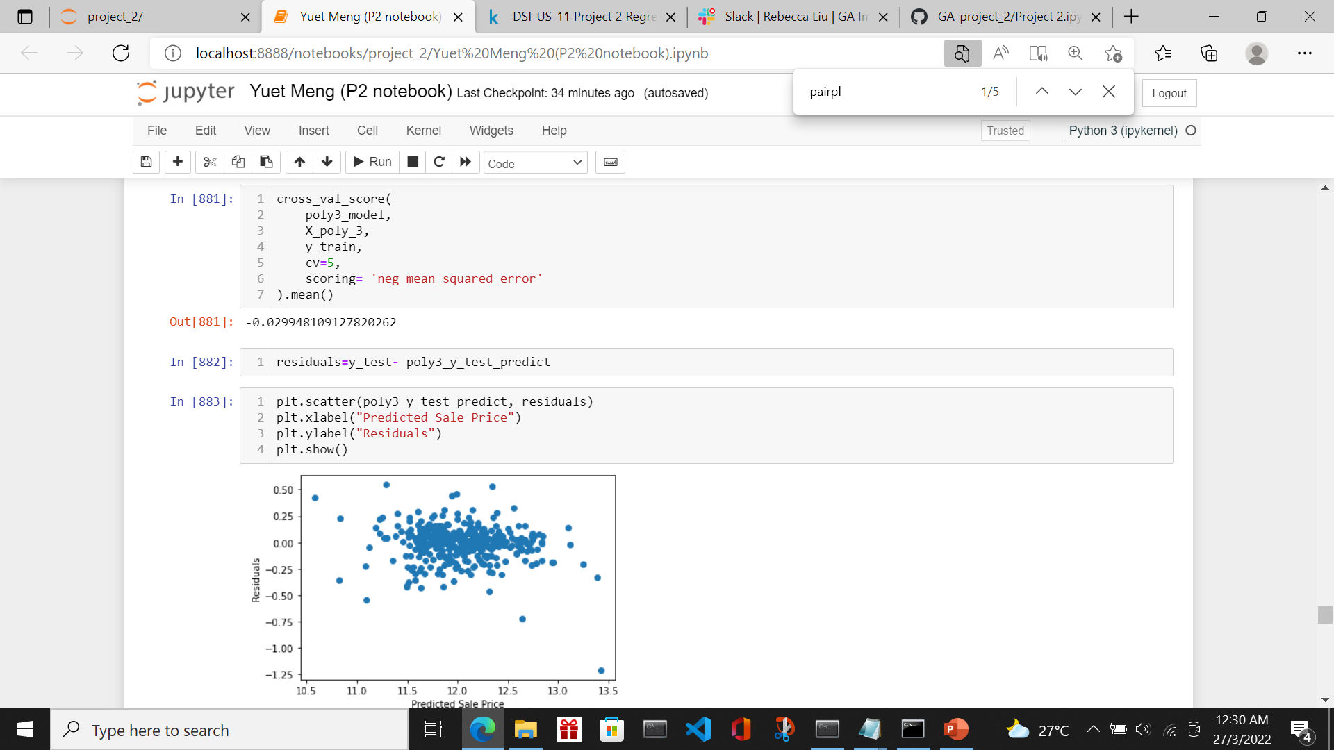
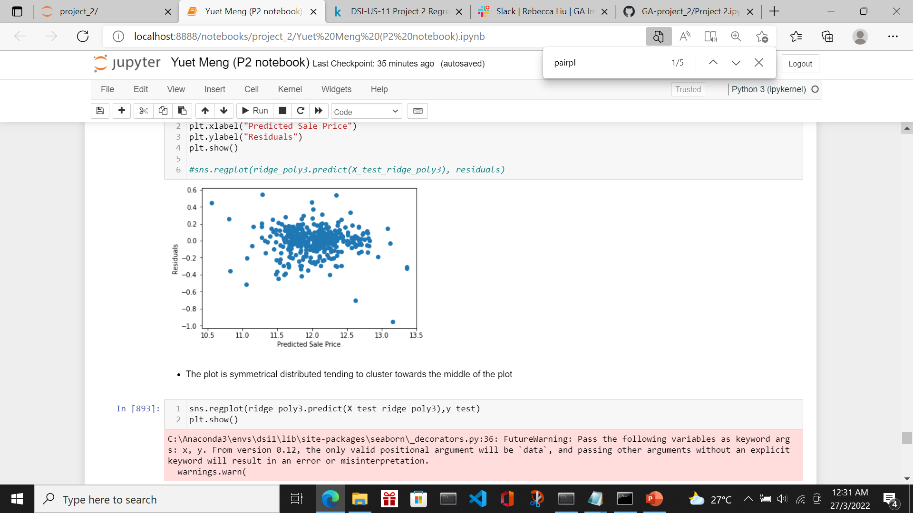
Train/score/evaluate of models
Model 4 used variables: Overall Qual, totalsqft, Kitchen Qual, Garage Cars,Total Baths,
Fireplace Qu, age but with polynomial Degree 3
I tested using Linear Regression, Ridge Regression
Model | Degree | Residue vs Predicted Plot | Remark
Linear Regression | 3 |  | The points in the plot are pretty symmetrically distributed tending to cluster towards the middle of the plot
Ridge Regression | 3 |  | The points in the plot are pretty symmetrically distributed tending to cluster towards the middle of the plot

Slide 28
Train/score/evaluate of models
Model 2 Scores
Model | Degree | MSE (train) | MSE (test) | CVS | Remark
Linear Regression | 3 | 0.01851985 | 0.02644404 | 0.029948109127820262 | Overfitting as MSE Train and MSE Test deviates
Ridge Regression | 3 | 0.019229721417379997 | 0.02414408565724339 | 0.026347308615236743 | Overfitting as MSE Train and MSE Test deviates

Slide 29
Train/score/evaluate of models
Shortlisting of the more desirable models
Model | Degree | MSE (train) | MSE (test) | CVS | Remark
Model 1 - Ridge Regression | 1 | 0.02392817964988823 | 0.02258433059028586 | 0.02427708430597085
Model 2 - Lasso Regression | 2 | 0.022539032281693936 | 0.02185415307219567 | 0.02399888774648144 | Selected this as best model
Model 3 -Lasso Regression | 2 | 0.023330669785984002 | 0.024226242692108962 | 0.024909124969940515
I selected Lasso Regression with alpha=0.0037649358067924675 Degree 2 as the best model based on the MSE and CVS score. On top of it, I validated the residue plot against predicted price. The plot is random and even distributed. As for the actual value versus predicted value, it is linear and acceptable.
Although this is more complex model, areas of improvement is explained in layman term to the customers. There is no concern in using the complexed mode

Slide 30
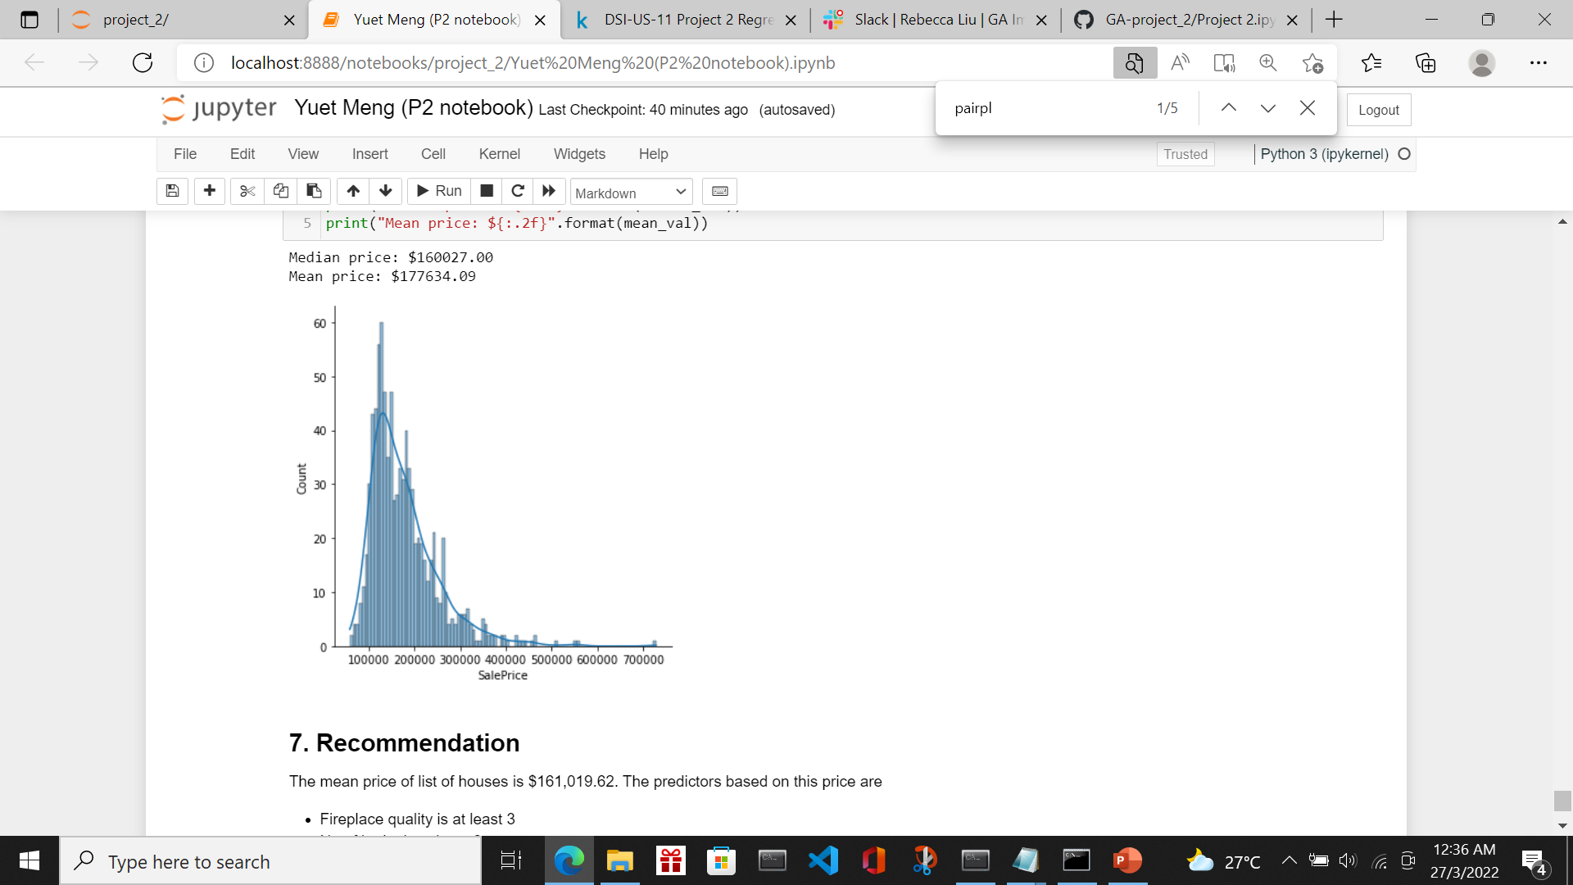
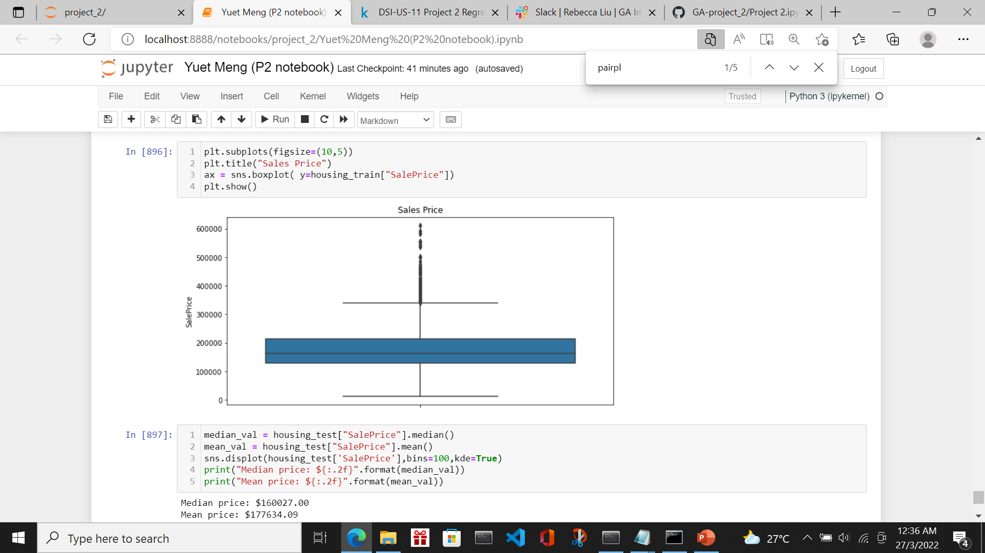
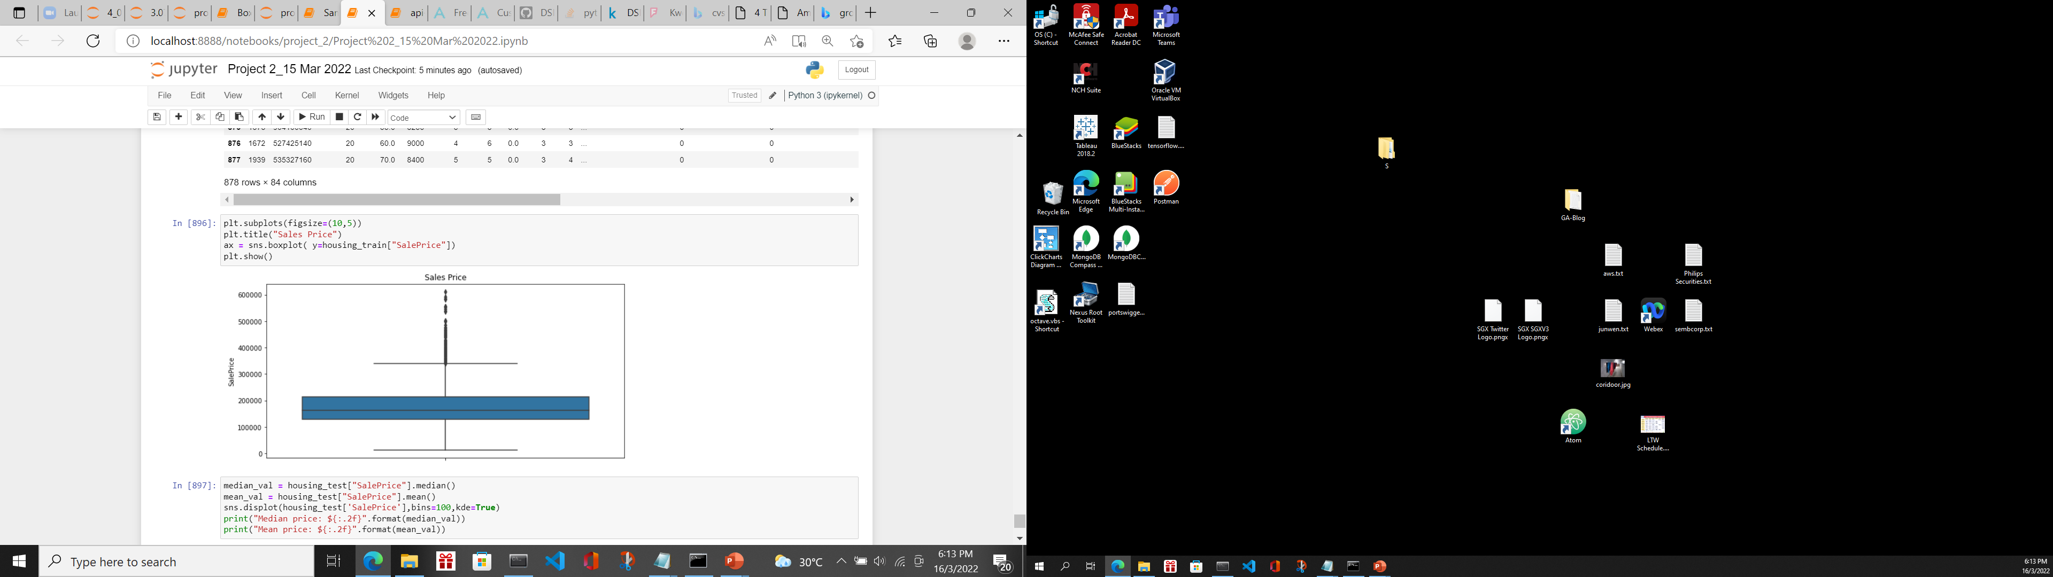
conclusion
I selected the Lasso Regression with Degree 2 alpha=0.0037649358067924675 with the lowest CVS. The mean price of list of houses is $160,027 and the median price is $177,634

Slide 31
conclusion
The mean price of list of houses is $161,019.62.
The predictors based on this price are
Fireplace quality is at least 3
No of baths is at least 2
Garage Cars is at least 2
External Quality is at least 3
Kitchen Quality is at least 3
Overall Quality is at least 3
To fetch a higher price, we can improve the External Quality, Kitchen Quality and Overall Quality, Fireplace Quality of the house
Approval to set the predicted price as the baseline price for the houses

